Slide 1
My Place in Tech
Software Quality Assurance

Slide 2
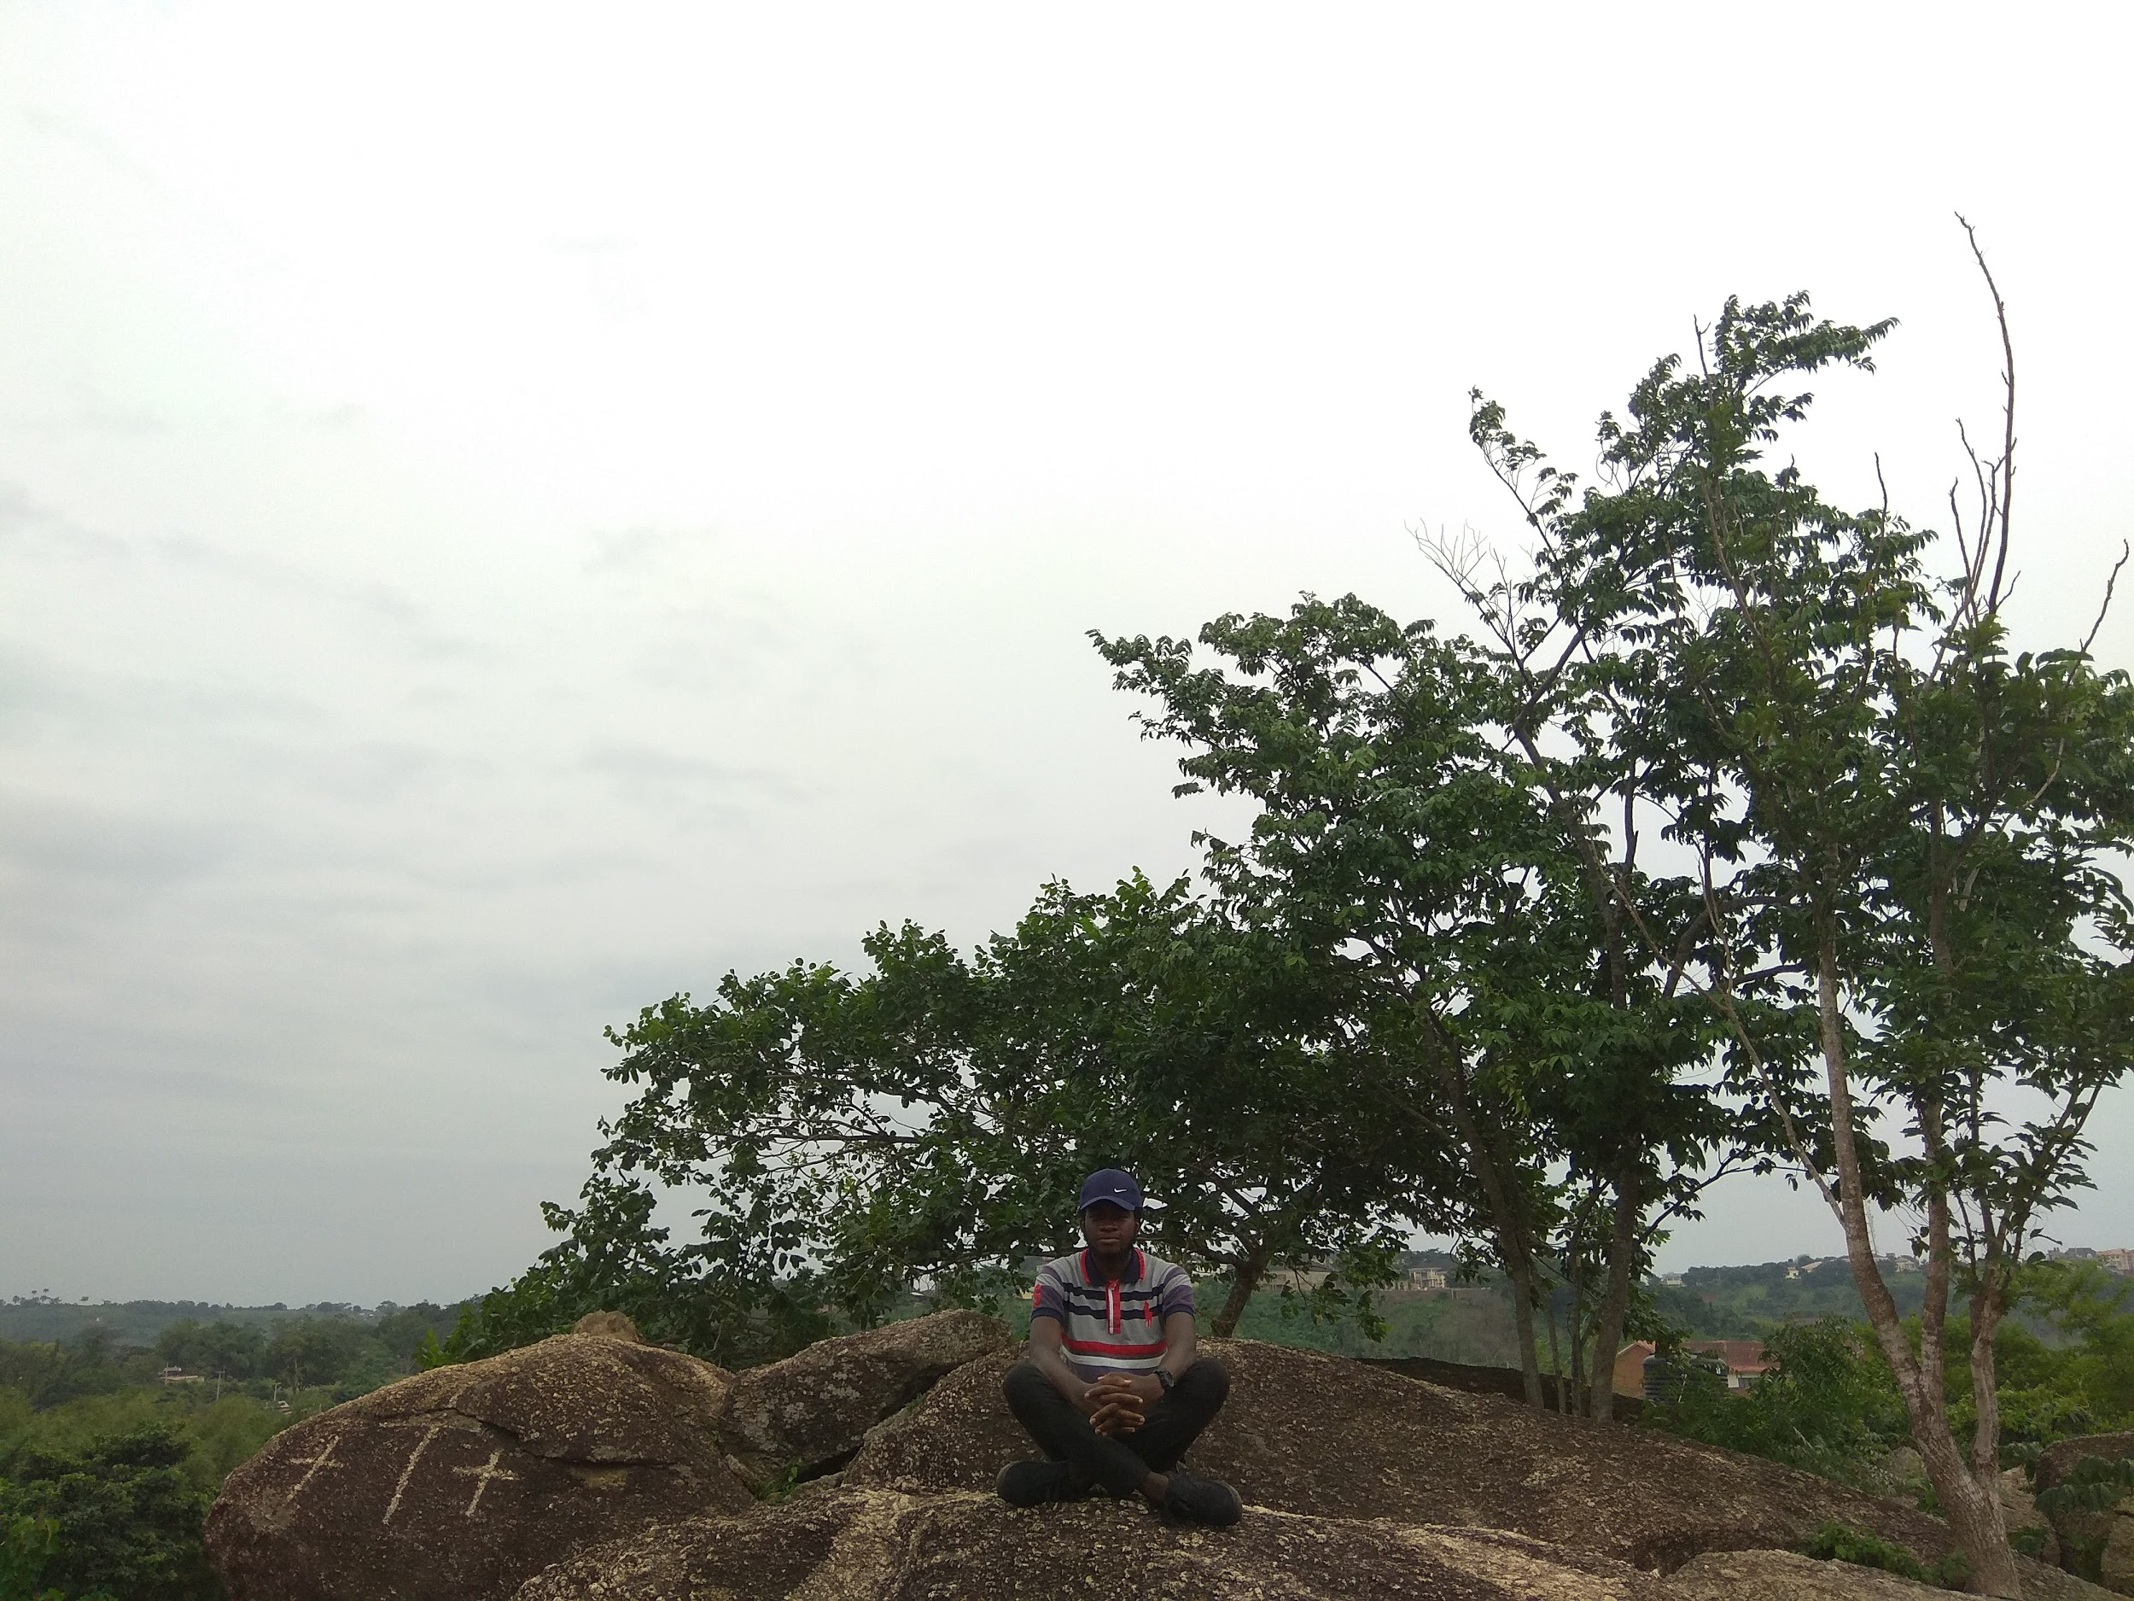
About Me
Gbenro Oni
Software QA Engineer
Musichead, Anime Lover, Sports
Twitter: @gbensky

Slide 3
Overview of Quality Assurance
Problem Solving
User Requirement
Customer Satisfaction

Slide 4
Relevance
Watch this

Slide 5
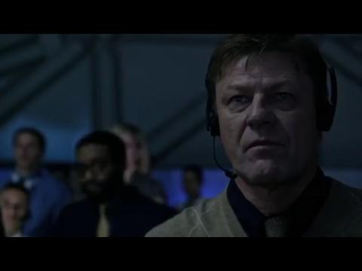
Relevance

Slide 6
Impact in my place of work
Let me share an experience from one of our projects

Slide 7
Job prospects
Software Tester
Quality Assurance Engineer
Quality Manager
Test Automation Engineer
ETL Tester
Many More

Slide 8
